Slide 1
Non-convex Optimization for Machine Learning
Prateek Jain
Microsoft Research India

Slide 2
Outline
Optimization for Machine Learning
Non-convex Optimization
Convergence to Stationary Points
First order stationary points
Second order stationary points
Non-convex Optimization in ML
Neural Networks
Learning with Structure
Alternating Minimization
Projected Gradient Descent

Slide 3
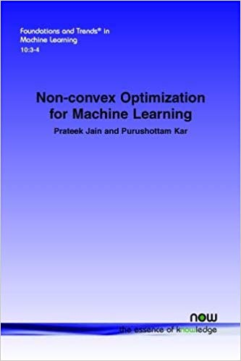
Relevant Monograph (Shameless Ad)

Slide 4
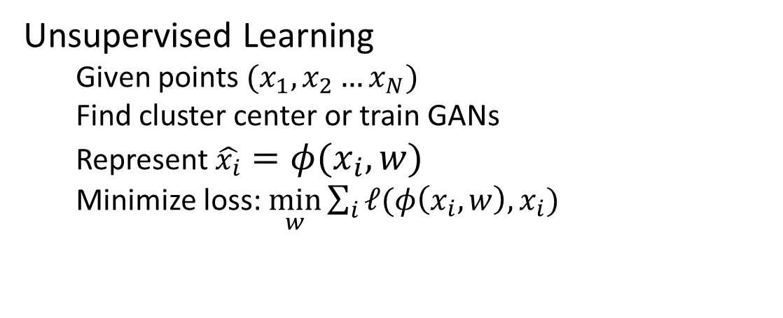
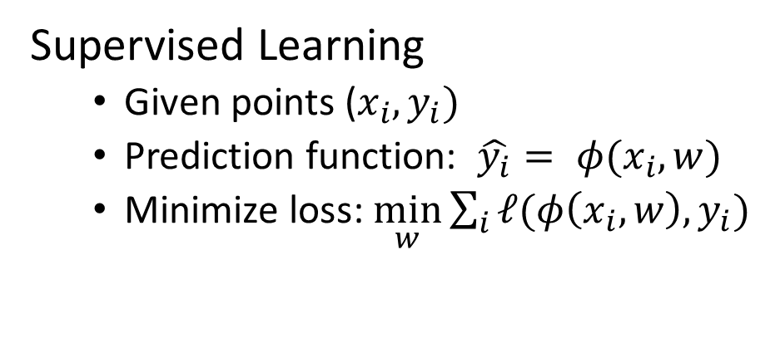
Optimization in ML
Supervised Learning
Given points ($x_{i}, y_{i})$
Prediction function: $\hat{y_{i}}= φ(x_{i}, w)$
Minimize loss: $\min_{w}{\sum_{i}{ℓ(φ\left(x_{i}, w\right), y_{i})}}$
Unsupervised Learning
Given points $(x_{1},x_{2}…x_{N})$
Find cluster center or train GANs
Represent $\hat{x_{i}}=φ(x_{i}, w)$
Minimize loss: $\min_{w}{\sum_{i}{ℓ(φ\left(x_{i}, w\right), x_{i})}}$

Slide 5
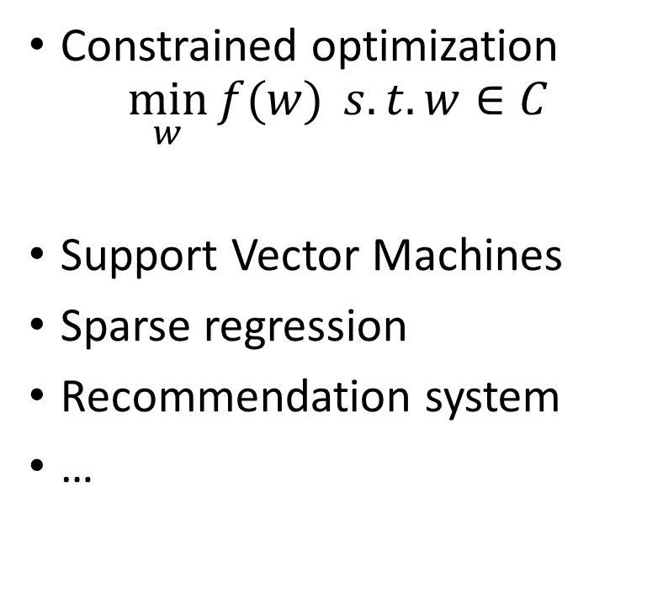
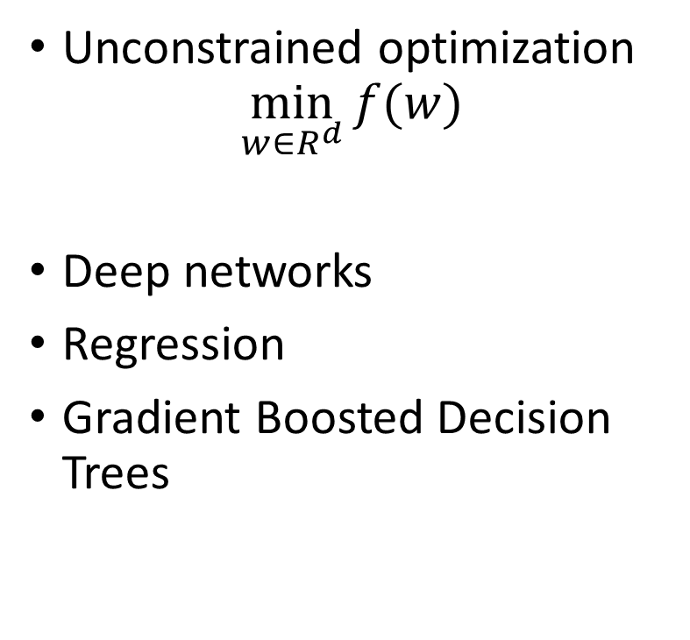
Optimization Problems
Unconstrained optimization
$$\min_{w∈R^{d}}{f(w)}$$
Deep networks
Regression
Gradient Boosted Decision Trees
Constrained optimization
$$\min_{w}{f(w)} s.t. w∈C$$
Support Vector Machines
Sparse regression
Recommendation system
…

Slide 6
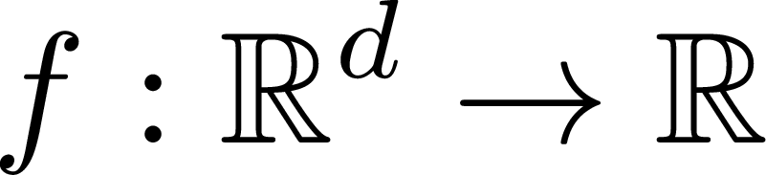
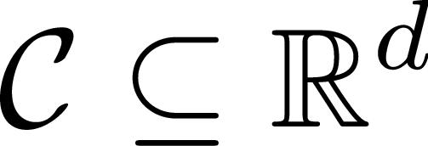


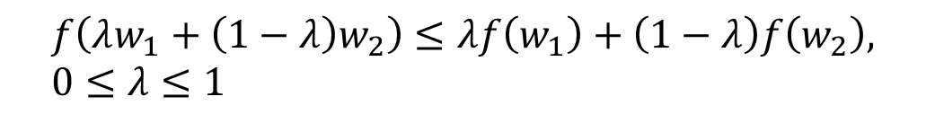
Convex Optimization
$$\min_{w}{f(w)} \\ s.t. w∈C$$
Convex function
Convex set
$$∀w_{1},w_{2}∈C, λw_{1}+\left(1−λ\right)w_{2}∈C \\ 0≤λ≤1$$
$$f\left(λw_{1}+\left(1−λ\right)w_{2}\right)≤λf\left(w_{1}\right)+\left(1−λ\right)f\left(w_{2}\right), \\ 0≤λ≤1$$
Slide credit: Purushottam Kar

Slide 7
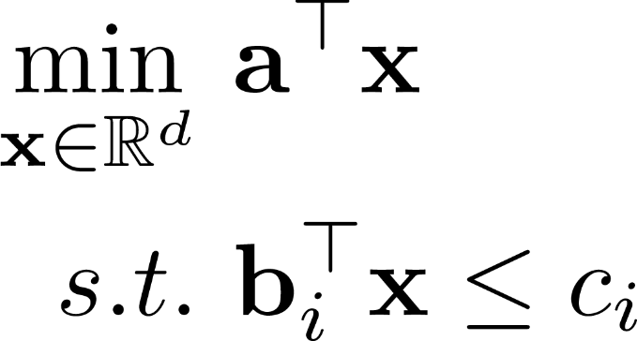
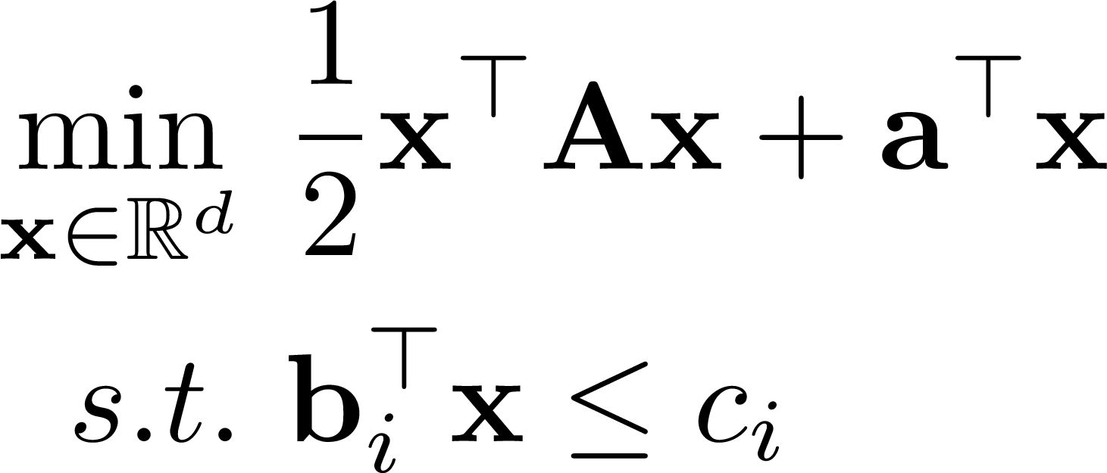
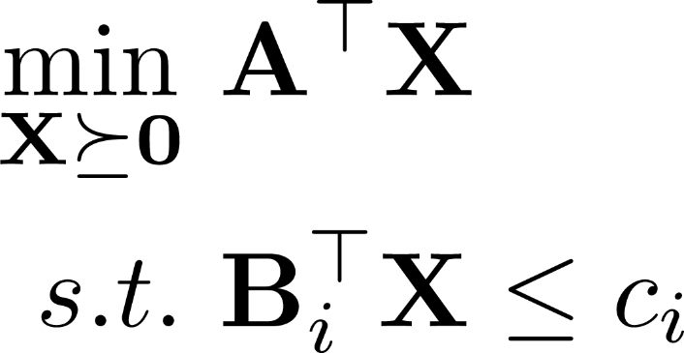
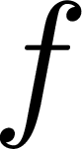
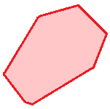

Examples
Linear Programming
Quadratic Programming
Semidefinite Programming
Slide credit: Purushottam Kar

Slide 8
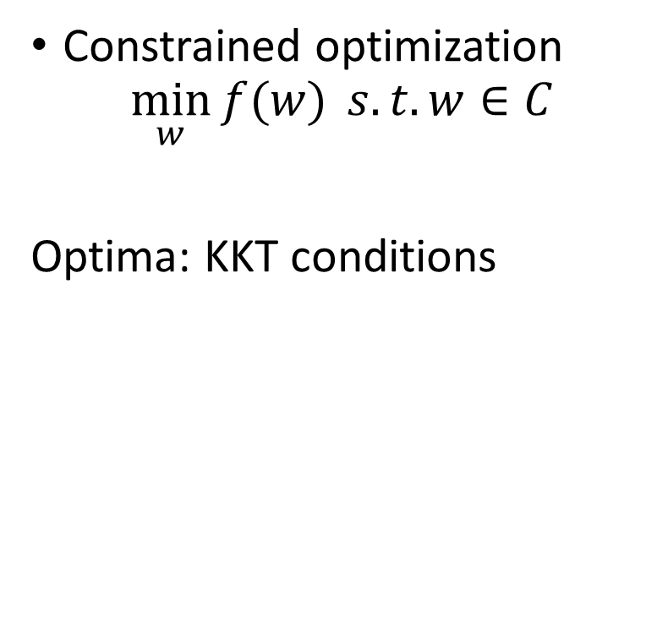
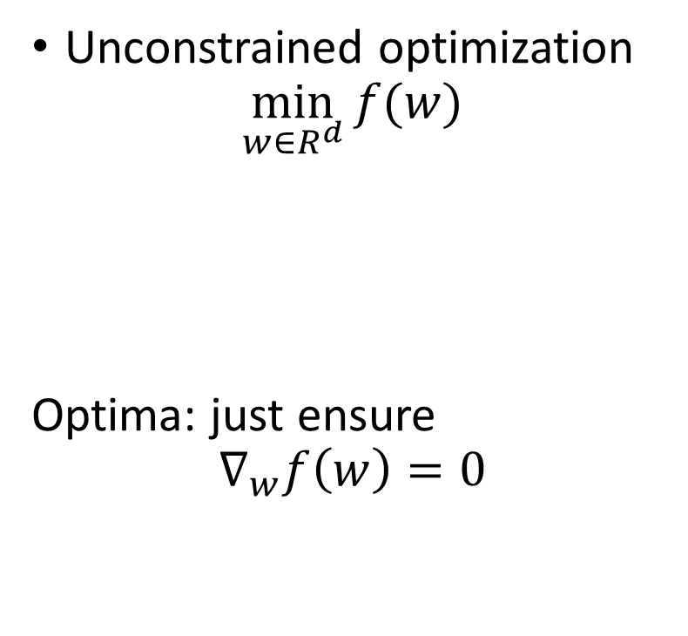
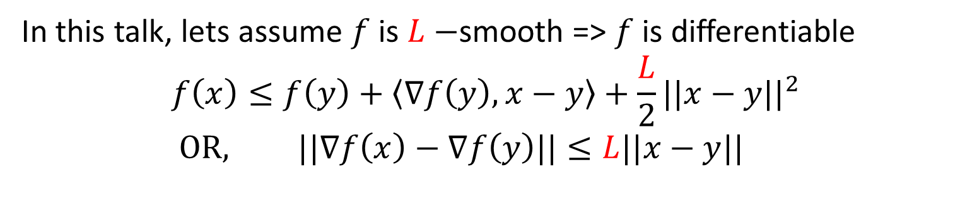
Convex Optimization
Unconstrained optimization
$$\min_{w∈R^{d}}{f(w)}$$
Optima: just ensure
$$∇_{w}f\left(w\right)=0$$
Constrained optimization
$$\min_{w}{f(w)} s.t. w∈C$$
Optima: KKT conditions
In this talk, lets assume $f$ is $L−$smooth => $f$ is differentiable
$$f\left(x\right)≤f\left(y\right)+\left\langle ∇f\left(y\right), x−y\right\rangle +\frac{L}{2}||x−y||^{2} \\ OR, ||∇f\left(x\right)−∇f\left(y\right)||≤L||x−y||$$

Slide 9
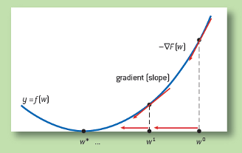
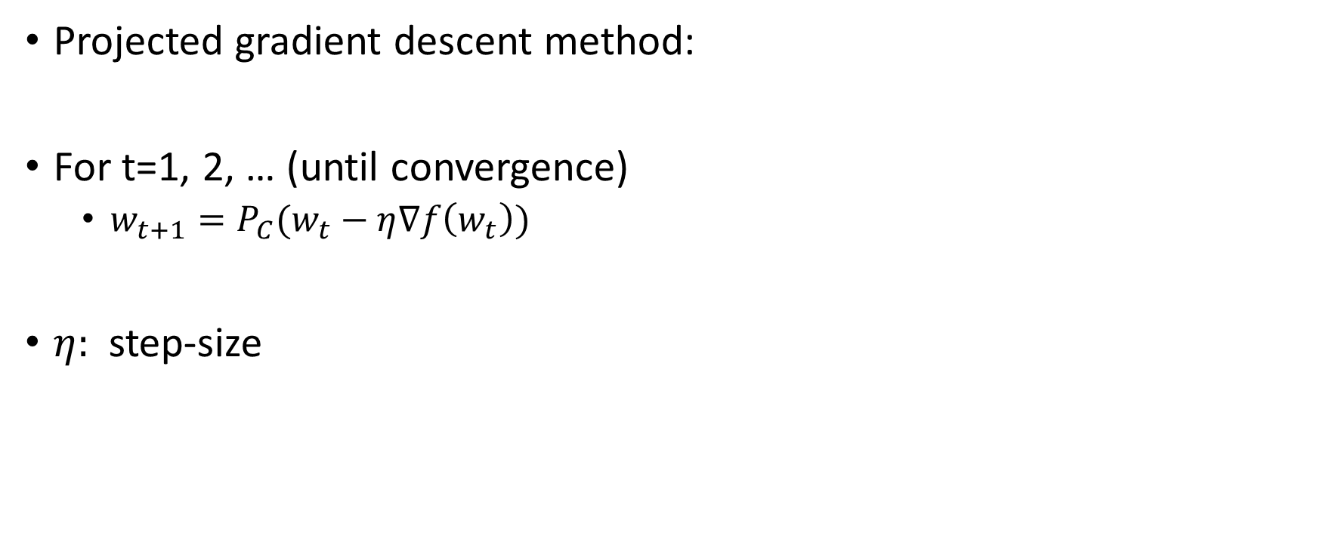
Gradient Descent Methods
Projected gradient descent method:
For t=1, 2, … (until convergence)
$w_{t+1}=P_{C}(w_{t}−η∇f\left(w_{t}\right))$
$η:$ step-size

Slide 10
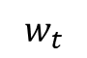
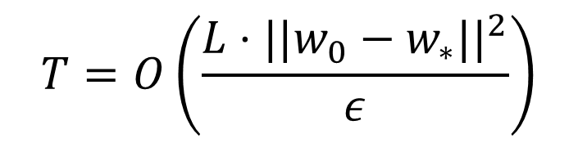
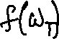
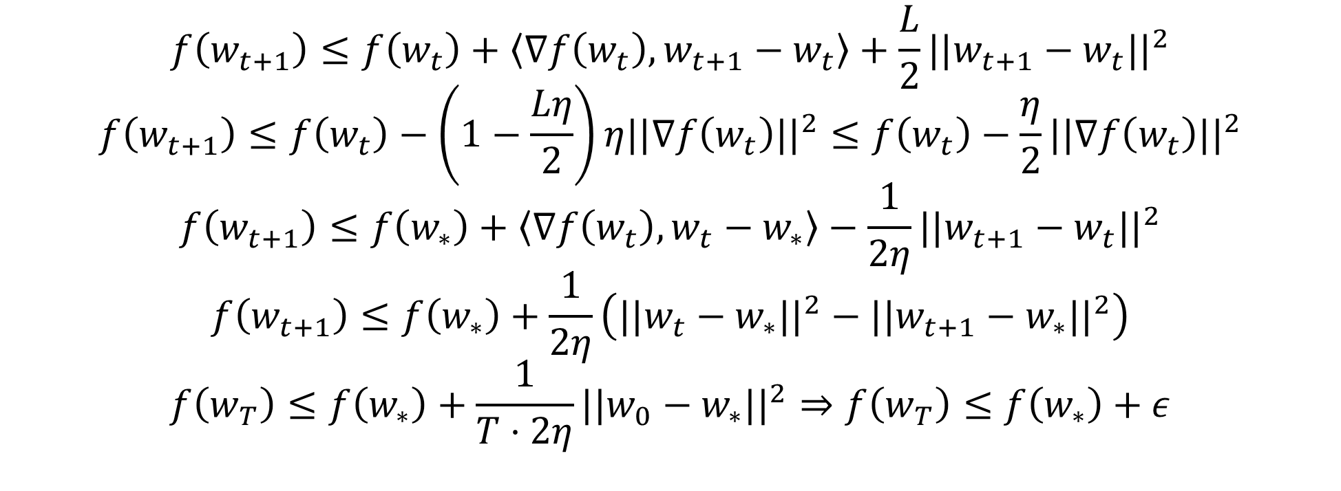
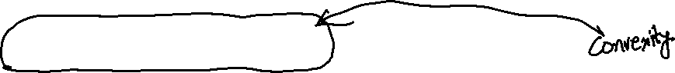

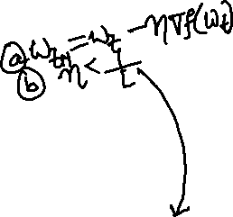
Convergence Proof
$$w_{t}$$
$$f\left(w_{t+1}\right)≤f\left(w_{t}\right)+\left\langle ∇f\left(w_{t}\right), w_{t+1}−w_{t}\right\rangle +\frac{L}{2}||w_{t+1}−w_{t}||^{2}$$
$$f\left(w_{t+1}\right)≤f\left(w_{t}\right)−\left(1−\frac{Lη}{2}\right)η||∇f\left(w_{t}\right)||^{2}≤f\left(w_{t}\right)−\frac{η}{2}||∇f\left(w_{t}\right)||^{2}$$
$$f\left(w_{t+1}\right)≤f\left(w_{∗}\right)+\left\langle ∇f\left(w_{t}\right),w_{t}−w_{∗}\right\rangle −\frac{1}{2η}||w_{t+1}−w_{t}||^{2}$$
$$f\left(w_{t+1}\right)≤f\left(w_{∗}\right)+\frac{1}{2η}\left(||w_{t}−w_{∗}||^{2}−||w_{t+1}−w_{∗}||^{2}\right)$$
$$f\left(w_{T}\right)≤f\left(w_{∗}\right)+\frac{1}{T⋅2η}||w_{0}−w_{∗}||^{2}⇒f\left(w_{T}\right)≤f\left(w_{∗}\right)+ε$$
$$T=O\left(\frac{L⋅||w_{0}−w_{∗}||^{2}}{ε}\right)$$

Slide 11
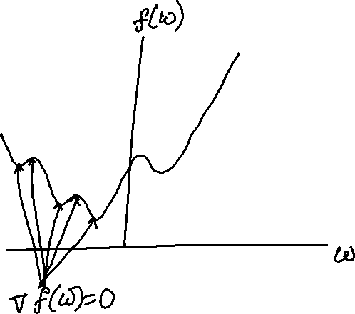
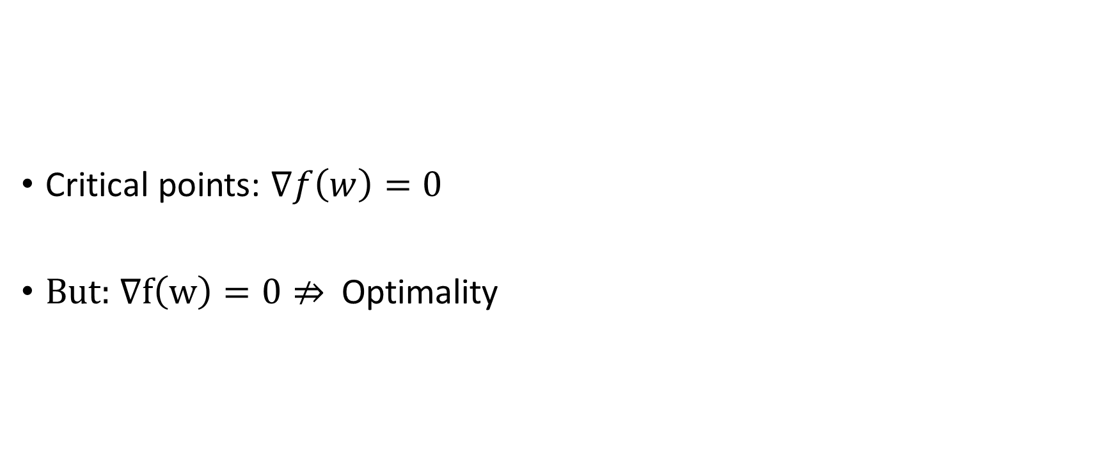
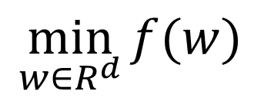
Non-convexity?
$$\min_{w∈R^{d}}{f(w)}$$
Critical points: $∇f\left(w\right)=0$
But: $∇f\left(w\right)=0⇏$Optimality

Slide 12
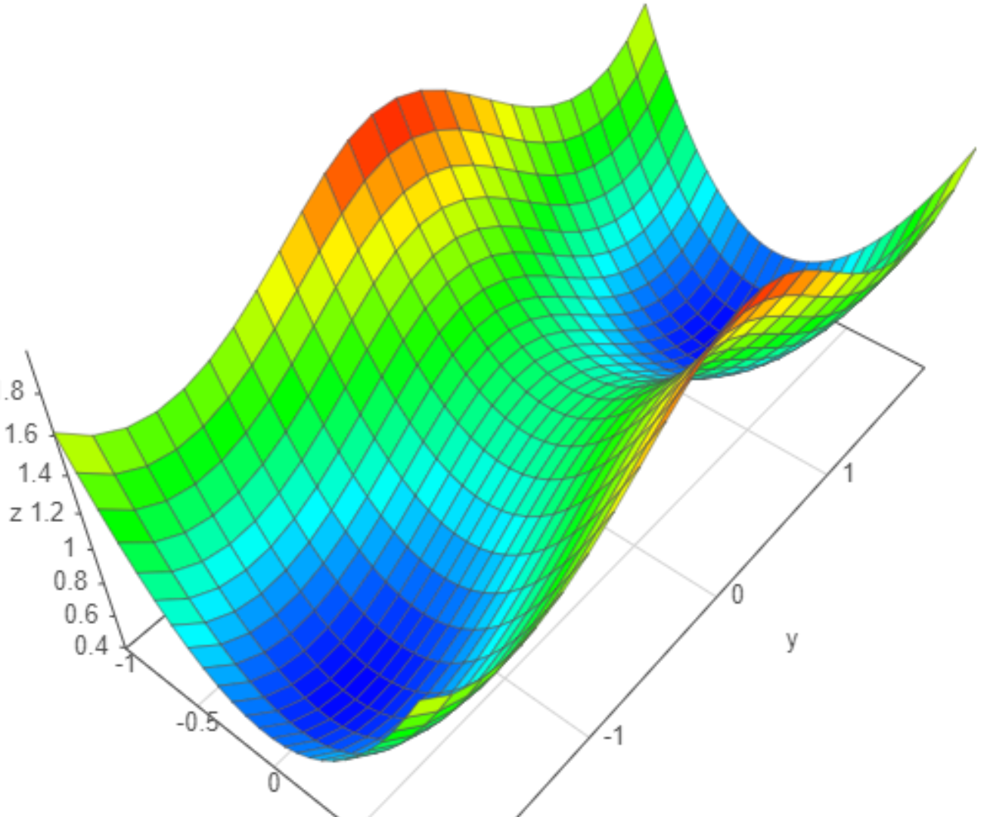
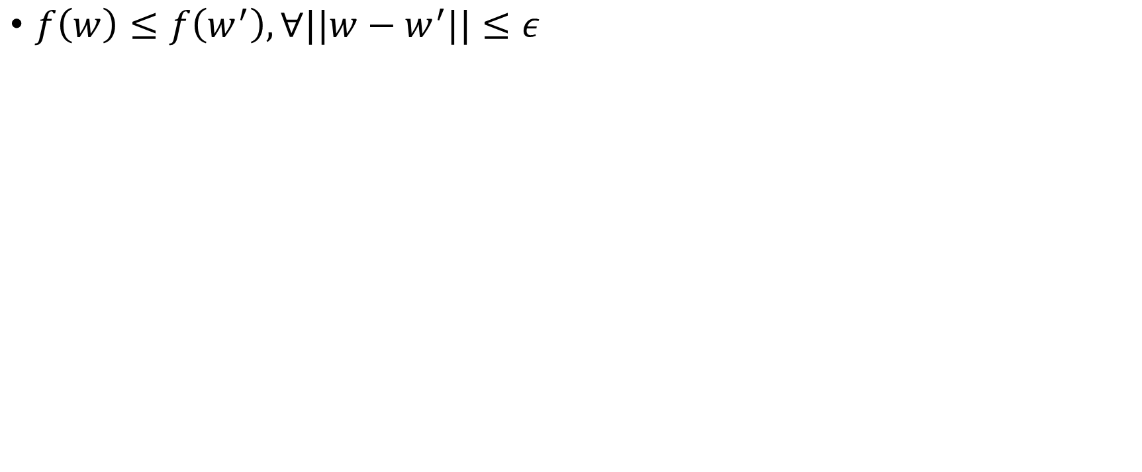
Local Optima
$f\left(w\right)≤f\left(w^{′}\right), ∀||w−w^{′}||≤ε$
Local Minima
image credit: academo.org

Slide 13
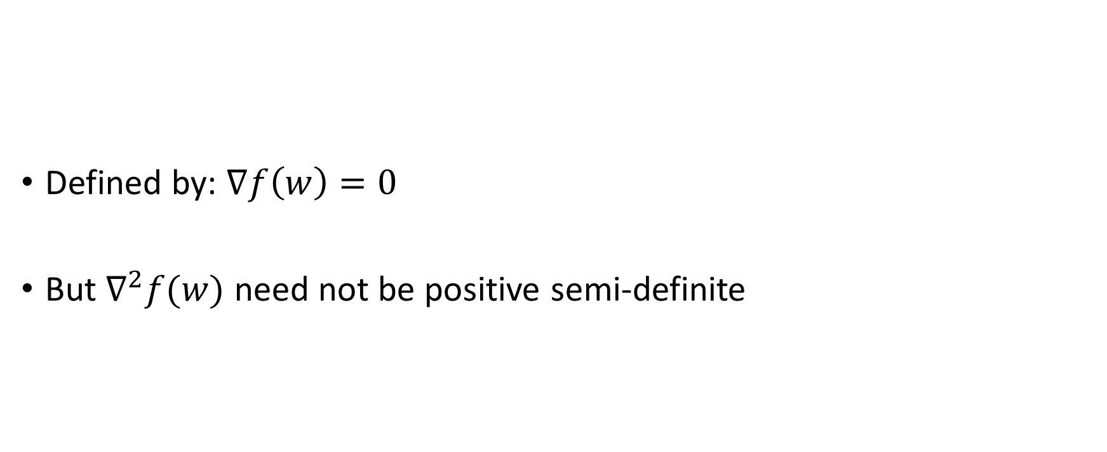
First Order Stationary Points
First Order Stationary Point (FOSP)
Defined by: $∇f\left(w\right)=0$
But $∇^{2}f(w)$ need not be positive semi-definite
image credit: academo.org

Slide 14
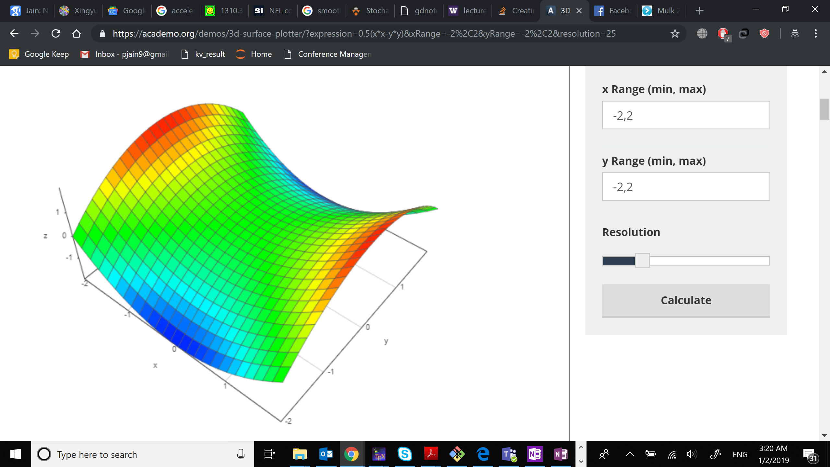
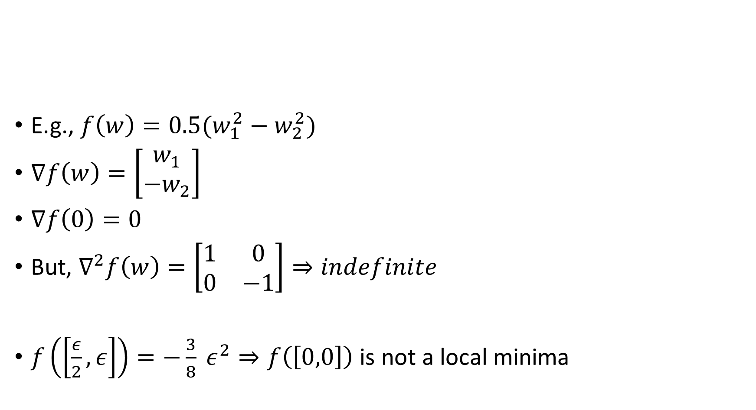
First Order Stationary Points
E.g., $f\left(w\right)=0.5(w_{1}^{2}−w_{2}^{2})$
$∇f\left(w\right)=\left[\begin{matrix}w_{1} \\ −w_{2}\end{matrix}\right]$
$∇f\left(0\right)=0$
But, $∇^{2}f\left(w\right)=\left[\begin{matrix}1 & 0 \\ 0 & −1\end{matrix}\right]⇒indefinite$
$f\left(\left[\frac{ε}{2}, ε\right]\right)=−\frac{3}{8} ε^{2}⇒f\left(\left[0,0\right]\right)$ is not a local minima
First Order Stationary Point (FOSP)
image credit: academo.org

Slide 15
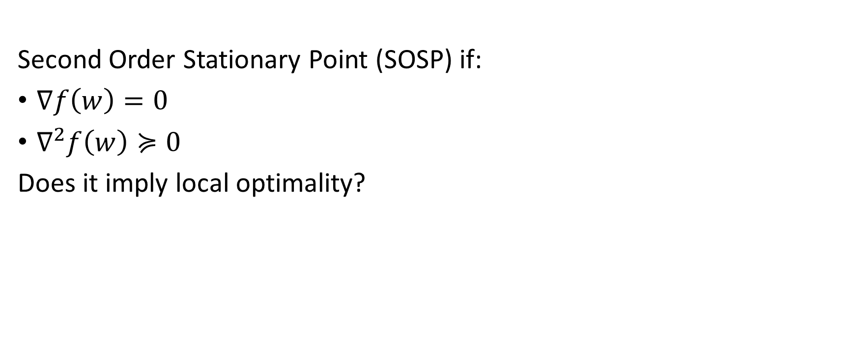
Second Order Stationary Points
Second Order Stationary Point (SOSP) if:
$∇f\left(w\right)=0$
$∇^{2}f\left(w\right)≽0$
Does it imply local optimality?
Second Order Stationary Point (SOSP)
image credit: academo.org

Slide 16
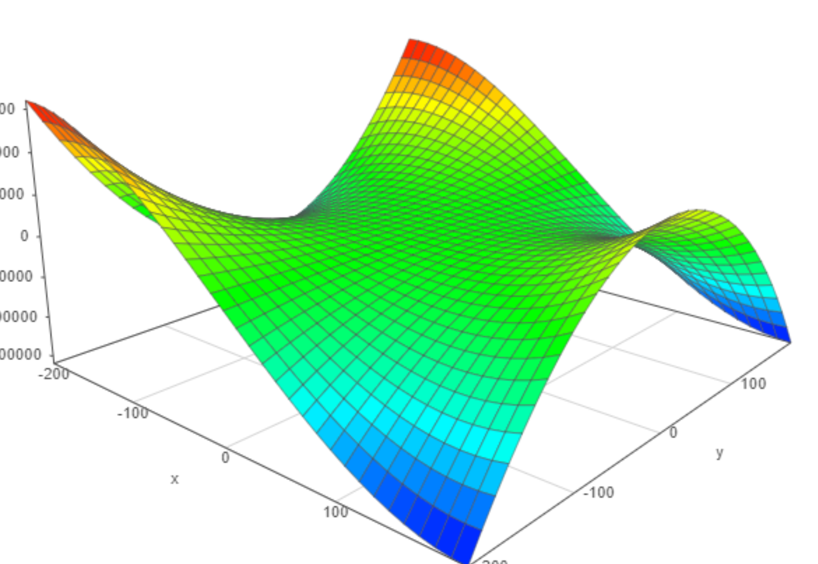
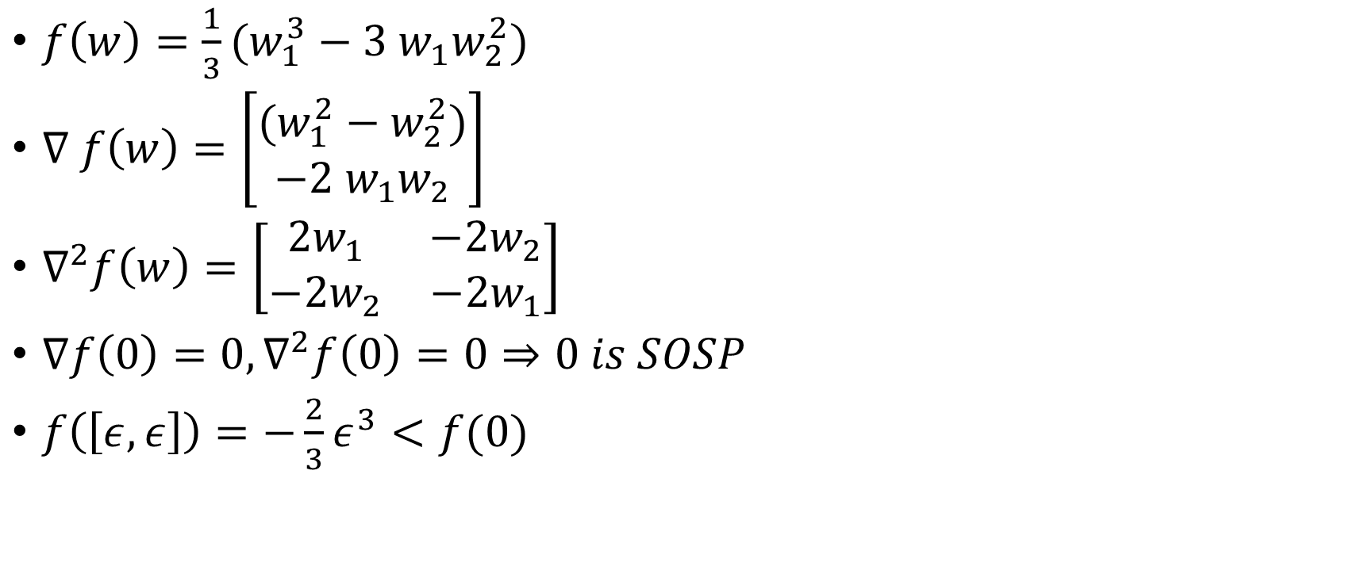
Second Order Stationary Points
$f\left(w\right)=\frac{1}{3}(w_{1}^{3}−3 w_{1}w_{2}^{2})$
$∇ f\left(w\right)=\left[\begin{matrix}(w_{1}^{2}−w_{2}^{2}) \\ −2 w_{1}w_{2}\end{matrix}\right]$
$∇^{2}f\left(w\right)=\left[\begin{matrix}2w_{1} & −2w_{2} \\ −2w_{2} & −2w_{1}\end{matrix}\right]$
$∇f\left(0\right)=0, ∇^{2}f\left(0\right)=0⇒0 is SOSP$
$f\left(\left[ε, ε\right]\right)=−\frac{2}{3}ε^{3}<f(0)$
Second Order Stationary Point (SOSP)
image credit: academo.org

Slide 17
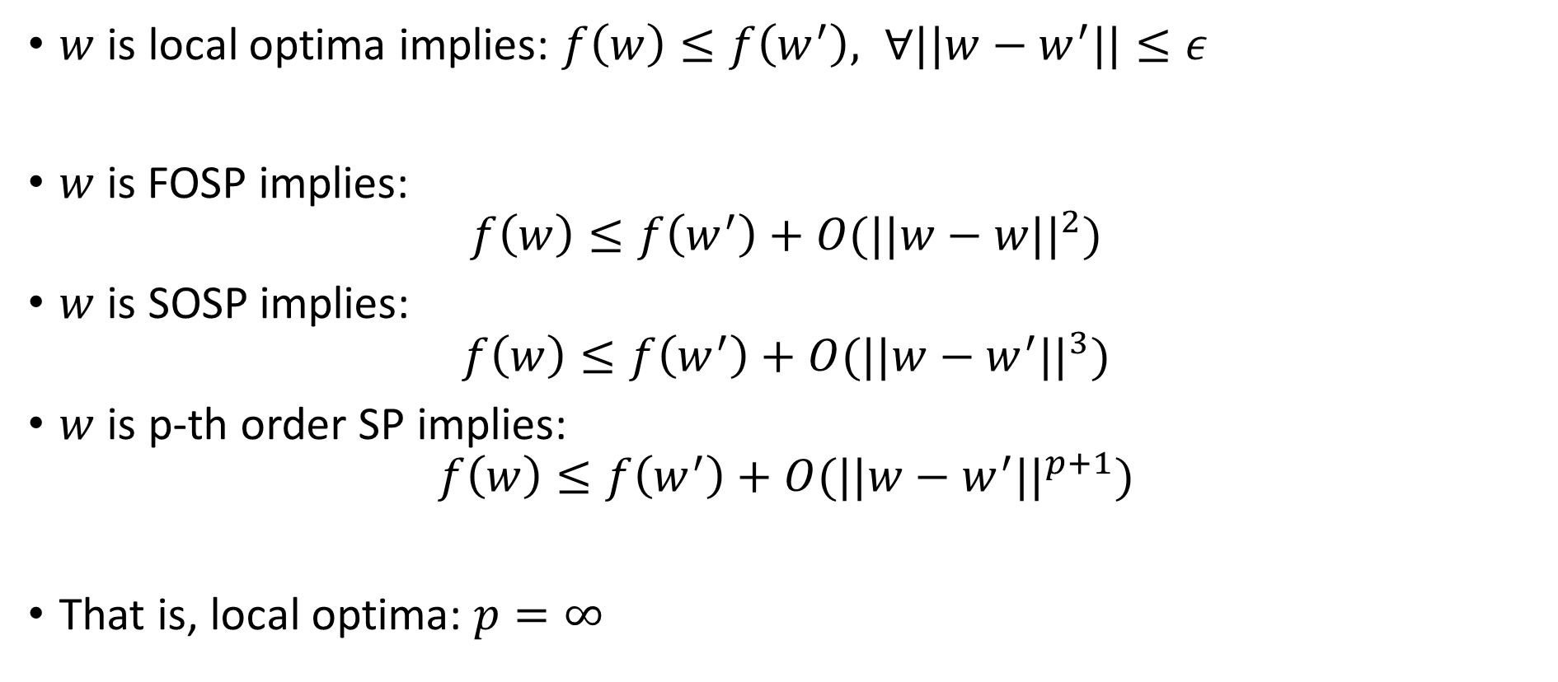
Stationarity and local optima
$w$ is local optima implies: $f\left(w\right)≤f\left(w^{′}\right), ∀||w−w^{′}||≤ε$
$w$ is FOSP implies:
$$f\left(w\right)≤f\left(w^{′}\right)+O(||w−w||^{2})$$
$w$ is SOSP implies:
$$f\left(w\right)≤f\left(w^{′}\right)+O(||w−w^{′}||^{3})$$
$w$ is p-th order SP implies:
$$f\left(w\right)≤f\left(w^{′}\right)+O(||w−w^{′}||^{p+1})$$
That is, local optima: $p=∞$

Slide 18


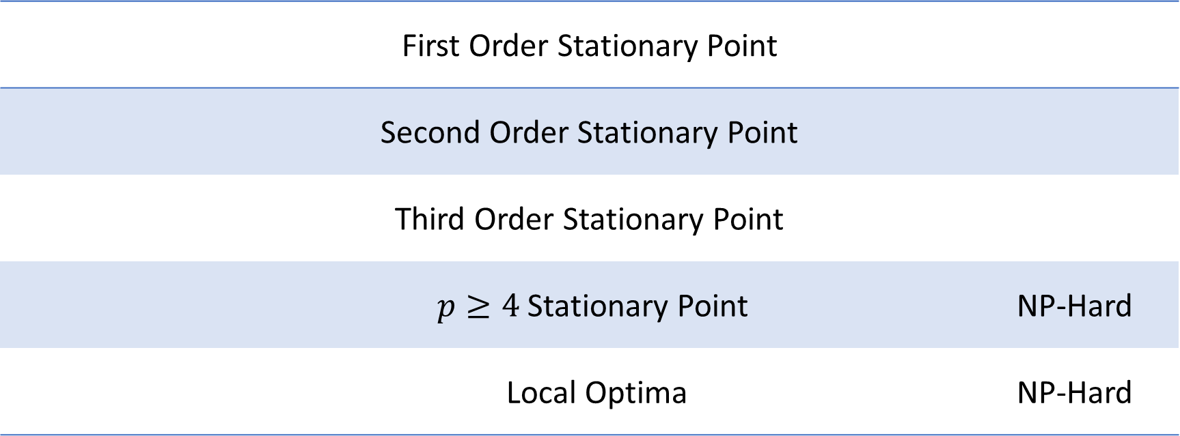
Computability?
$$f\left(w\right)≤f\left(w^{′}\right)+O(||w−w^{′}||^{p+1})$$
First Order Stationary Point
Second Order Stationary Point
Third Order Stationary Point
$p≥4$ Stationary Point NP-Hard
Local Optima NP-Hard
Anandkumar and Ge-2016

Slide 19
Does Gradient Descent Work for Local Optimality?
Yes!
In fact, with high probability converges to a “local minimizer”
If initialized randomly!!!
But no rates known ☹
NP-hard in general!!
Big open problem ☺
image credit: academo.org

Slide 20
Finding First Order Stationary Points
First Order Stationary Point (FOSP)
Defined by: $∇f\left(w\right)=0$
But $∇^{2}f(w)$ need not be positive semi-definite
image credit: academo.org

Slide 21
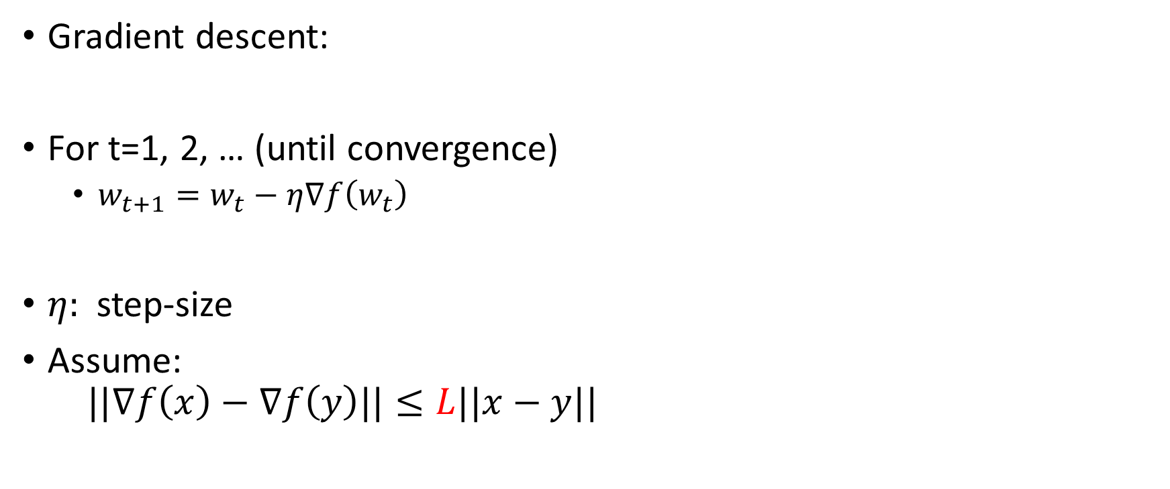
Gradient Descent Methods
Gradient descent:
For t=1, 2, … (until convergence)
$w_{t+1}=w_{t}−η∇f\left(w_{t}\right)$
$η:$ step-size
Assume: $||∇f\left(x\right)−∇f\left(y\right)||≤L||x−y||$

Slide 22
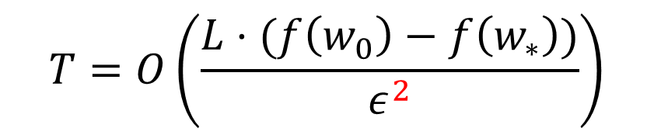
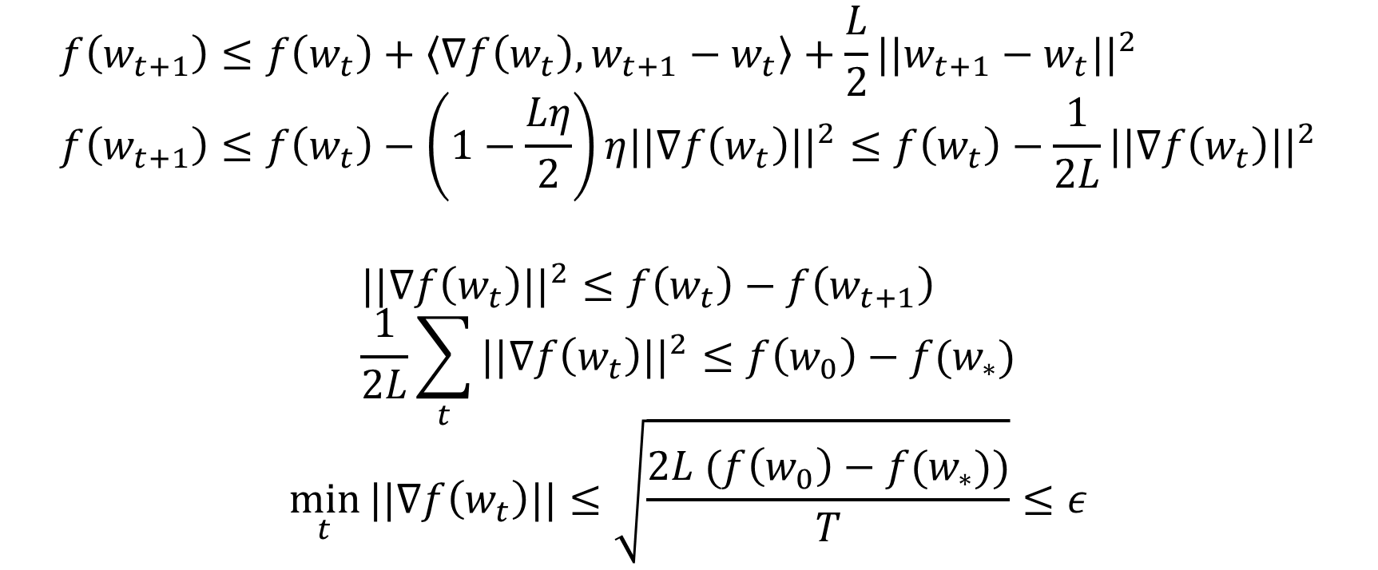
Convergence to FOSP
$$f\left(w_{t+1}\right)≤f\left(w_{t}\right)+\left\langle ∇f\left(w_{t}\right), w_{t+1}−w_{t}\right\rangle +\frac{L}{2}||w_{t+1}−w_{t}||^{2} \\ f\left(w_{t+1}\right)≤f\left(w_{t}\right)−\left(1−\frac{Lη}{2}\right)η||∇f\left(w_{t}\right)||^{2}≤f\left(w_{t}\right)−\frac{1}{2L}||∇f\left(w_{t}\right)||^{2}$$
$$||∇f\left(w_{t}\right)||^{2}≤f\left(w_{t}\right)−f\left(w_{t+1}\right) \\ \frac{1}{2L}\sum_{t}{||∇f\left(w_{t}\right)||^{2}≤f\left(w_{0}\right)−f(w_{∗})}$$
$$\min_{t}{||∇f\left(w_{t}\right)||≤\sqrt{\frac{2L (f\left(w_{0}\right)−f(w_{∗}))}{T}}}≤ε$$
$$T=O\left(\frac{L⋅(f\left(w_{0}\right)−f\left(w_{∗}\right))}{ε^{2}}\right)$$

Slide 23
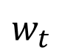
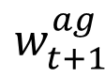
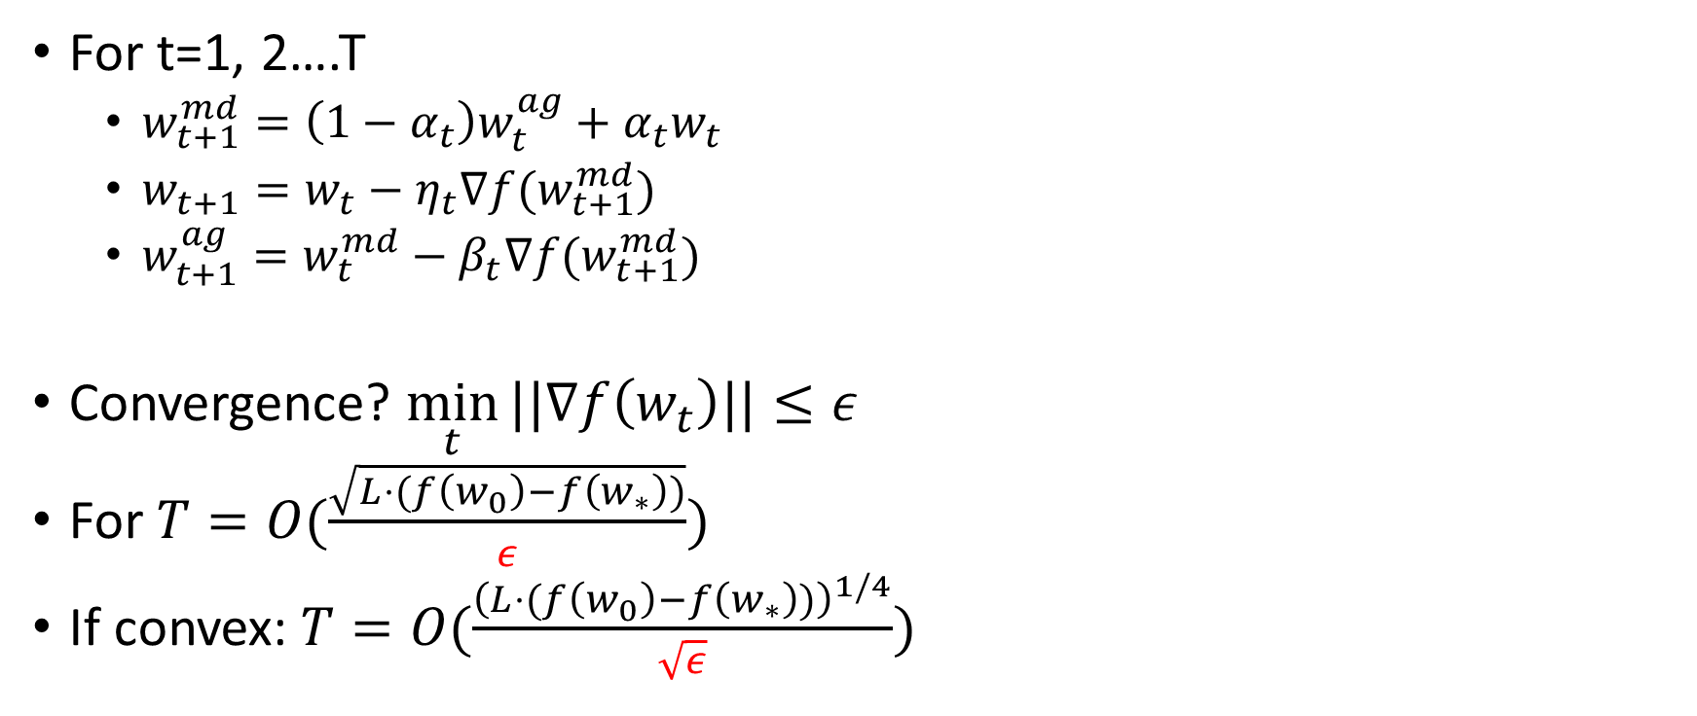
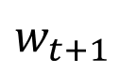
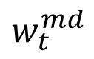
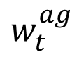
Accelerated Gradient Descent for FOSP?
$$w_{t}^{md}$$
$$w_{t}^{ag}$$
$$w_{t}$$
For t=1, 2….T
$w_{t+1}^{md}=\left(1−α_{t}\right)w_{t}^{ag}+α_{t}w_{t}$
$w_{t+1}=w_{t}−η_{t}∇f(w_{t+1}^{md})$
$w_{t+1}^{ag}=w_{t}^{md}−β_{t}∇f(w_{t+1}^{md})$
Convergence? $\min_{t}{||∇f\left(w_{t}\right)||}≤ε$
For $T=O(\frac{\sqrt{L⋅(f\left(w_{0}\right)−f\left(w_{∗}\right))}}{ε})$
If convex: $T=O(\frac{{\left(L⋅(f\left(w_{0}\right)−f\left(w_{∗}\right))\right)}^{1/4}}{\sqrt{ε}})$
$$w_{t+1}$$
$$w_{t+1}^{ag}$$
Ghadimi and Lan - 2013

Slide 24
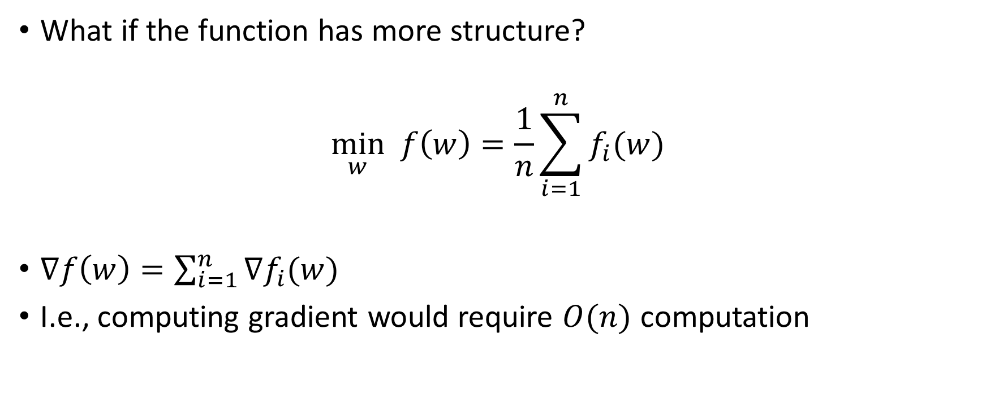
Non-convex Optimization: Sum of Functions
What if the function has more structure?
$$\min_{w} f\left(w\right)=\frac{1}{n}\sum_{i=1}^{n}{f_{i}(w)}$$
$∇f\left(w\right)=\sum_{i=1}^{n}{∇f_{i}(w)}$
I.e., computing gradient would require $O(n)$ computation

Slide 25
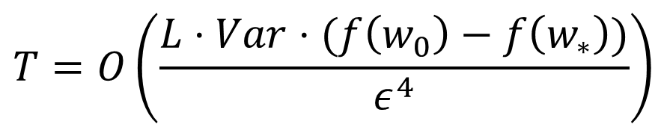
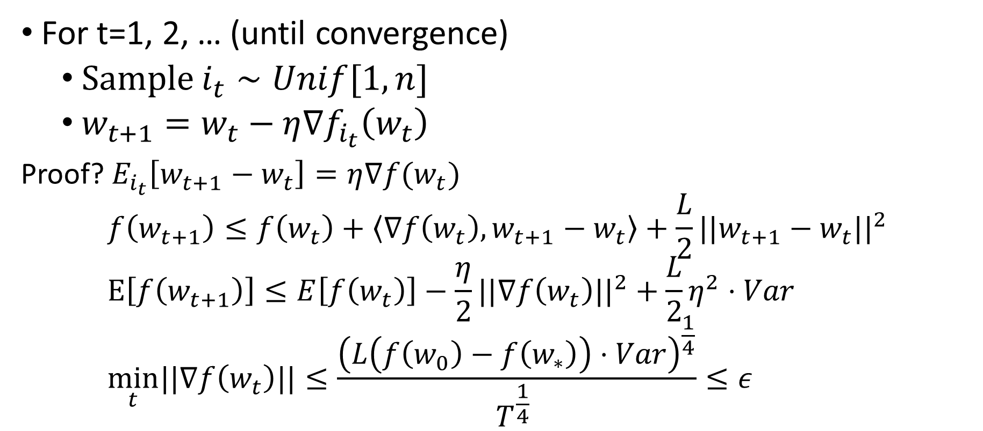
Does Stochastic Gradient Descent Work?
For t=1, 2, … (until convergence)
Sample $i_{t}∼Unif[1,n]$
$w_{t+1}=w_{t}−η∇f_{i_{t}}\left(w_{t}\right)$
Proof? $E_{i_{t}}\left[w_{t+1}−w_{t}\right]=η∇f(w_{t})$
$$f\left(w_{t+1}\right)≤f\left(w_{t}\right)+\left\langle ∇f\left(w_{t}\right), w_{t+1}−w_{t}\right\rangle +\frac{L}{2}||w_{t+1}−w_{t}||^{2} \\ E\left[f\left(w_{t+1}\right)\right]≤E\left[f\left(w_{t}\right)\right]−\frac{η}{2}||∇f\left(w_{t}\right)||^{2}+\frac{L}{2}η^{2}⋅Var \\ \min_{t}||∇f\left(w_{t}\right)||≤\frac{{\left(L\left(f\left(w_{0}\right)−f\left(w_{∗}\right)\right)⋅Var\right)}^{\frac{1}{4}}}{T^{\frac{1}{4}} }≤ε$$
$$T=O\left(\frac{L⋅Var⋅(f\left(w_{0}\right)−f\left(w_{∗}\right))}{ε^{4}}\right)$$

Slide 26
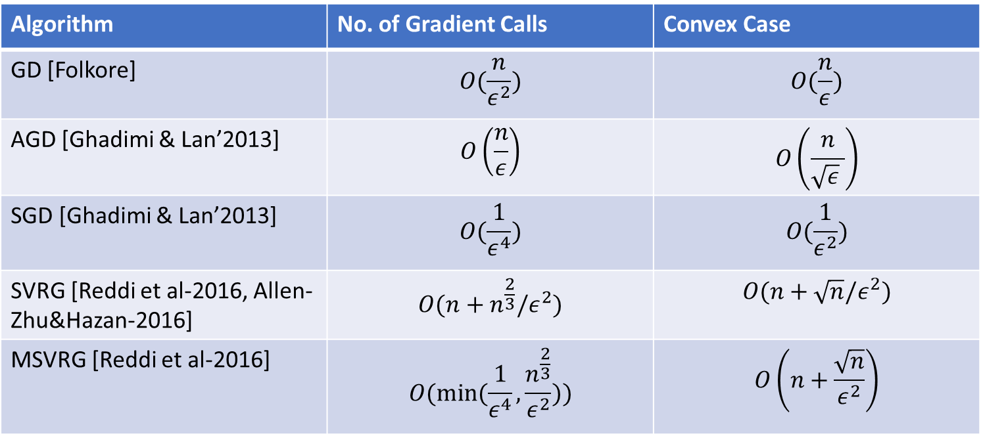


Summary: Convergence to FOSP
Algorithm | No. of Gradient Calls (Non-convex) | No. of Gradient Calls (Convex)
GD [Folkore; Nesterov] | $$O\left(\frac{1}{ε^{2}}\right)$$ | $$O\left(\frac{1}{ε}\right)$$
AGD [Ghadimi & Lan-2013] | $$O\left(\frac{1}{ε}\right)$$ | $$O\left(\frac{1}{\sqrt{ε}}\right)$$
Algorithm | No. of Gradient Calls | Convex Case
GD [Folkore] | $$O(\frac{n}{ε^{2}})$$ | $$O(\frac{n}{ε})$$
AGD [Ghadimi & Lan’2013] | $$O\left(\frac{n}{ε}\right)$$ | $$O\left(\frac{n}{\sqrt{ε} }\right)$$
SGD [Ghadimi & Lan’2013] | $$O(\frac{1}{ε^{4}})$$ | $$O(\frac{1}{ε^{2}})$$
SVRG [Reddi et al-2016, Allen-Zhu&Hazan-2016] | $$O(n+n^{\frac{2}{3}}/ε^{2})$$ | $$O(n+\sqrt{n}/ε^{2})$$
MSVRG [Reddi et al-2016] | $$O(min⁡(\frac{1}{ε^{4}},\frac{n^{\frac{2}{3}}}{ε^{2}}))$$ | $$O\left(n+\frac{\sqrt{n}}{ε^{2}}\right)$$
$$f\left(w\right)=\frac{1}{n}\sum_{i=1}^{n}{f_{i}(w)}$$

Slide 27

Finding Second Order Stationary Points (SOSP)
Second Order Stationary Point (SOSP) if:
$∇f\left(w\right)=0$
$∇^{2}f\left(w\right)≽0$
Approximate SOSP:
$||∇f\left(w\right)||≤ε$
$λ_{min}\left(∇^{2}f\left(w\right)\right)≥−\sqrt{ρε}$
Second Order Stationary Point (SOSP)
image credit: academo.org

Slide 28

Cubic Regularization (Nesterov and Polyak-2006)
For t=1, 2, … (until convergence)
$$w_{t+1}=\arg{\min_{w}{f\left(w_{t}\right)+\left\langle w−w_{t}, ∇f\left(w_{t}\right)\right\rangle +\frac{1}{2} {\left(w−w_{t}\right)}^{T}∇^{2}f\left(w_{t}\right)\left(w−w_{t}\right)+\frac{ρ}{6}||w−w_{t}||^{3}}}$$
Assumption: Hessian continuity, i.e., $||∇^{2}f\left(x\right)−∇^{2}f\left(y\right)||≤ρ||x−y||$
Convergence to SOSP? $T=O(\frac{1}{ε^{1.5}})$
But requires Hessian computation! (even storage is $O(d^{2})$
Can we find SOSP using only gradients?

Slide 29

Noisy Gradient Descent for SOSP
For t=1, 2, … (until convergence)
If ( $||∇f(w_{t}||≥ε$ )
$w_{t+1}=w_{t}−η∇f\left(w_{t}\right)$
Else
$w_{t+1}=w_{t}+ζ, ζ∼γ⋅N(0, I)$
Update $w_{t+1}=w_{t}−η∇f\left(w_{t}\right)$ for next $r$ iterations
Claim: above algorithm converges to SOSP in $O(1/ε^{2})$
Ge et al-2015, Jin et al-2017

Slide 30


Proof
For t=1, 2, … (until convergence)
If ( $||∇f(w_{t}||≥ε$ )
$$w_{t+1}=w_{t}−η∇f\left(w_{t}\right)$$
Else
$$w_{t+1}=w_{t}+ζ, ζ∼γ⋅N(0, I)$$
Update $w_{t+1}=w_{t}−η∇f\left(w_{t}\right)$ for next $r$ iterations
FOSP analysis: convergence in $O\left(\frac{1}{ε^{2}}\right)$ iterations
But, $∇^{2}f\left(w_{t}\right) ≱0$
That is, $λ_{min}\left(∇^{2}f\left(w_{t}\right)\right)<−\sqrt{ρε}$
image credit: academo.org

Slide 31
Proof
For t=1, 2, … (until convergence)
If ( $||∇f(w_{t}||≥ε$ )
$$w_{t+1}=w_{t}−η∇f\left(w_{t}\right)$$
Else
$$w_{t+1}=w_{t}+ζ, ζ∼γ⋅N(0, I)$$
Update $w_{t+1}=w_{t}−η∇f\left(w_{t}\right)$ for next $r$ iterations
Random perturbation with Gradient descent leads to decrease in objective function
image credit: academo.org

Slide 32




Proof?
For t=1, 2, … (until convergence)
If ( $||∇f(w_{t}||≥ε$ )
$$w_{t+1}=w_{t}−η∇f\left(w_{t}\right)$$
Else
$$w_{t+1}=w_{t}+ζ, ζ∼γ⋅N(0, I)$$
Update $w_{t+1}=w_{t}−η∇f\left(w_{t}\right)$ for next $r$ iterations
Random perturbation with Gradient descent leads to decrease in objective function
Hessian continuity => function nearly quadratic in small neighborhood
$f\left(w\right)≈f\left(w_{t}\right)+\left\langle ∇f\left(w_{t}\right), w−w_{t}\right\rangle +{\left(w−w_{t}\right)}^{T}∇^{2}f\left(w_{t}\right)(w−w_{t})$
$$w_{r+t}=w_{r−1+t}−η∇^{2}f\left(w_{t}\right)\left(w_{r−1+t}−w_{t}\right)$$ $⇒w_{r+t }−w_{t}={\left(I−η∇^{2}f\left(w_{t}\right)\right)}^{r}\left(w_{t+1}−w_{t}\right)$

Slide 33


Proof?
For t=1, 2, … (until convergence)
If ( $||∇f(w_{t}||≥ε$ )
$$w_{t+1}=w_{t}−η∇f\left(w_{t}\right)$$
Else
$$w_{t+1}=w_{t}+ζ, ζ∼γ⋅N(0, I)$$
Update $w_{t+1}=w_{t}−η∇f\left(w_{t}\right)$ for next $r$ iterations
Random perturbation with Gradient descent leads to decrease in objective function
Hessian continuity => function nearly quadratic in small neighborhood
$f\left(w\right)≈f\left(w_{t}\right)+\left\langle ∇f\left(w_{t}\right), w−w_{t}\right\rangle +{\left(w−w_{t}\right)}^{T}∇^{2}f\left(w_{t}\right)(w−w_{t})$ $w_{r+t}=w_{r−1+t}−η∇^{2}f\left(w_{t}\right)\left(w_{r−1+t}−w_{t}\right)$ $⇒w_{r+t }−w_{t}={\left(I−η∇^{2}f\left(w_{t}\right)\right)}^{r}\left(w_{t+1}−w_{t}\right)$
$w_{r+t}−w_{t}$ converge to largest eigenvector of $I−η∇^{2}f(w_{t})$
Which is smallest (most negative) eigenvector of $∇^{2}f(w_{t})$
Hence, ${\left(w_{r+t}−w_{t}\right)}^{T}∇^{2}f\left(w_{t}\right)\left(w_{r+t}−w_{t}\right)≤−γ^{2}\sqrt{ρε}$
$f\left(w_{r+t}\right)≤f\left(w_{t}\right)−γ^{2}\sqrt{ρε}$

Slide 34

Proof
For t=1, 2, … (until convergence)
If ( $||∇f(w_{t}||≥ε$ )
$$w_{t+1}=w_{t}−η∇f\left(w_{t}\right)$$
Else
$$w_{t+1}=w_{t}+ζ, ζ∼γ⋅N(0, I)$$
Update $w_{t+1}=w_{t}−η∇f\left(w_{t}\right)$ for next $r$ iterations
Entrapment near SOSP
Final result: convergence to SOSP in $O(1/ε^{2})$
image credit: academo.org
Ge et al-2015, Jin et al-2017

Slide 35



Summary: Convergence to SOSP
Algorithm | No. of Gradient Calls (Non-convex) | No. of Gradient Calls (Convex)
Noisy GD [Jin et al-2017, Ge et al-2015] | $$O\left(\frac{1}{ε^{2}}\right)$$ | $$O\left(\frac{1}{ε}\right)$$
Noisy Accelerated GD [Jin et al-2017] | $$O\left(\frac{1}{ε^{1.75}}\right)$$ | $$O\left(\frac{1}{\sqrt{ε}}\right)$$
Cubic Regularization [Nesterov & Polyak-2006] | $$O\left(\frac{1}{ε^{1.5}}\right)$$ | N/A
Algorithm | No. of Gradient Calls | Convex Case
Noisy GD [Jin et al-2017, Ge et al-2015] | $$O(\frac{n}{ε^{2}})$$ | $$O(\frac{n}{ε})$$
Noisy AGD [Jin et al-2017] | $$O\left(\frac{n}{ε^{1.75}}\right)$$ | $$O\left(\frac{n}{\sqrt{ε} }\right)$$
Noisy SGD [Jin et al-2017, Ge et al-2015] | $$O(\frac{1}{ε^{4}})$$ | $$O(\frac{1}{ε^{2}})$$
SVRG [Allen-Zhu-2018] | $$O(n+n^{\frac{3}{4}}/ε^{2})$$ | $$O(n+\sqrt{n}/ε^{2})$$
$$f\left(w\right)=\frac{1}{n}\sum_{i=1}^{n}{f_{i}(w)}$$

Slide 36
Convergence to Global Optima?
FOSP/SOSP methods can’t even guarantee local convergence
Can we guarantee global optimality for some “nicer” non-convex problems?
Yes!!!
Use statistics ☺
image credit: academo.org

Slide 37

Can Statistics Help: Realizable models!
Data points: $\left(x_{i}, y_{i}\right)∼D$
$D:$ nice distribution
$E[y_{i}]=φ(x_{i}, w_{∗})$
$$\hat{w}=\arg{\min_{w}{\sum_{i}{loss(y_{i}, φ(x_{i}, w)}}})$$
That is, $w_{∗}$ is the optimal solution!
Parameter learning

Slide 38









Learning Neural Networks: Provably
$$y_{i}$$
$$1$$
$$1$$
$$1$$
$$1$$
$$1$$
$y_{i}=1⋅σ\left(W_{∗}x_{i}\right)$
$x_{i}∼N(0, I)$
$$\min_{W}{\sum_{i}{{\left({ y}_{i}−1⋅σ\left(Wx_{i}\right)\right)}^{2}}}$$
Does gradient descent converge to global optima: $W_{∗}$?
NO!!!
The objective function has poor local minima [Shamir et al-2017, Lee et al-2017]
$$W_{∗}$$
$$x_{i}$$

Slide 39

Learning Neural Networks: Provably
But, no local minima within constant distance of $W_{∗}$
If,
$$||W_{0}−W_{∗}||≤c$$
Then, Gradient Descent ($W_{t+1}=W_{t}−η∇f(W_{t}))$ converges to $W_{∗}$
No. of iterations: $\log{1/ε}$
Can we get rid of initialization condition? Yes but by changing the network [Liang-Lee-Srikant’2018]
Zhong-Song-J-Bartlett-Dhillon’2017

Slide 40

Learning with Structure
$y_{i}=φ\left(x_{i}, w_{∗}\right), x_{i}∼D∈R^{d} , 1≤i≤n$
But no. of samples are limited!
For example, $if n≤d$?
Can we still recover $w_{∗}$? In general, no!
But, what if $w_{∗}$ has some structure?

Slide 41






Sparse Linear Regression
$\left[\begin{aligned}0.1 \\ 0 \\ 1 \\ ⋮ \\ 0.9\end{aligned}\right]$
$$⋮$$
d
=
n
$$y$$
=
$$X$$
$$w$$
But: $n≪d$
$w:s−$sparse ($s$ non-zeros)
Information theoretically: $n=s\log{d}$samples should suffice

Slide 42


Learning with structure
Linear classification/regression
$C=\{w, ||w||_{0}≤s\}$
$s≪d$
Matrix completion
$C=\{W, rank\left(W\right)≤r\}$
$r≪(d_{1},d_{2})$
$$\min_{w}{f(w)} \\ s.t. w∈C$$

Slide 43

Other Examples
Low-rank Tensor completion
$C=\{W, tensor−rank\left(W\right)≤r\}$
$r≪(d_{1},d_{2}, d_{3})$
Robust PCA
$C=\{W, W=L+S, rank\left(L\right)≤r, ||S||_{0}≤s\}$
$r≪\left(d_{1},d_{2}\right), S≪d_{1}×d_{2}$

Slide 44



Non-convex Structures
Linear classification/regression
$C=\{w, ||w||_{0}≤s\}$
$s≪d$
Matrix completion
$C=\{W, rank\left(W\right)≤r\}$
$r≪(d_{1},d_{2})$
NP-Hard
$||w||_{0}:$Non-convex
NP-Hard
$rank(W):$ Non-convex

Slide 45



Non-convex Structures
Low-rank Tensor completion
$C=\{W, tensor−rank\left(W\right)≤r\}$
$r≪(d_{1},d_{2}, d_{3})$
Robust PCA
$C=\{W, W=L+S, rank\left(L\right)≤r, ||S||_{0}≤s\}$
$r≪\left(d_{1},d_{2}\right), S≪d_{1}×d_{2}$
Indeterminate
$tensorrank\left(W\right):$Non-convex
NP-Hard
$rank\left(W\right), ||S||_{0}:$ Non-convex

Slide 46


Technique: Projected Gradient Descent
$$\min_{w}{f\left(w\right)} \\ s.t. w∈C$$
$w_{t+1}=w_{t}−∇_{w}f(w_{t})$
$w_{t+1}=P_{C}(w_{t+1})$
$$\min_{w}{||w−w_{t+1}||^{2}} \\ s.t. w∈C$$

Slide 47
Results for Several Problems
Sparse regression [Jain et al.’14, Garg and Khandekar’09]
Sparsity
Robust Regression [Bhatia et al.’15]
Sparsity+output sparsity
Vector-value Regression [Jain & Tewari’15]
Sparsity+positive definite matrix
Dictionary Learning [Agarwal et al.’14]
Matrix Factorization + Sparsity
Phase Sensing [Netrapalli et al.’13]
System of Quadratic Equations

Slide 48

Results Contd…
Low-rank Matrix Regression [Jain et al.’10, Jain et al.’13]
Low-rank structure
Low-rank Matrix Completion [Jain & Netrapalli’15, Jain et al.’13]
Low-rank structure
Robust PCA [Netrapalli et al.’14]
Low-rank $∩$ Sparse Matrices
Tensor Completion [Jain and Oh’14]
Low-tensor rank
Low-rank matrix approximation [Bhojanapalli et al.’15]
Low-rank structure

Slide 49

Sparse Linear Regression
$\left[\begin{aligned}0.1 \\ 0 \\ 1 \\ ⋮ \\ 0.9\end{aligned}\right]$
$$⋮$$
d
=
n
$$y$$
=
$$X$$
$$w$$
But: $n≪d$
$w:s−$sparse ($s$ non-zeros)

Slide 50

Sparse Linear Regression
$$\min_{w}{||y−Xw||^{2}} \\ s.t. ||w||_{0}≤s$$
$||y−Xw||^{2}=\sum_{i}{{\left(y_{i}−〈x_{i}, w〉\right)}^{2}}$
$||w||_{0}$: number of non-zeros
NP-hard problem in general ☹
$L_{0}$: non-convex function

Slide 51


Technique: Projected Gradient Descent
$$\min_{w}{f\left(w\right)=||y−Xw||^{2}} \\ s.t. ||w||_{0}≤s$$
$w_{t+1}=w_{t}−∇_{w}f(w_{t})$
$w_{t+1}=P_{s}(w_{t+1})$
$$\min_{w}{||w−w_{t+1}||^{2}} \\ s.t. ||w||_{0}≤s$$
[Jain, Tewari, Kar’2014]

Slide 52

Statistical Guarantees
$$y_{i}=〈x_{i}, w^{∗}〉+η_{i}$$
$x_{i}∼N(0, Σ)$
$η_{i}∼N(0, ζ^{2})$
$w^{∗}:s−$sparse
$$|| \hat{w}−w^{∗}||≤\frac{ζκ^{3}\sqrt{s\log{d}}}{\sqrt{n}}$$
$κ=λ_{1}(Σ)/λ_{d}(Σ)$
[Jain, Tewari, Kar’2014]

Slide 53


Low-rank Matrix Completion
$${\min_{W}{ \sum_{\left(i,j\right)∈Ω }{{\left(W_{ij}−M_{ij}\right)}^{2}}}}_{} \\ s.t rank\left(W\right)≤r$$
$Ω:$set of known entries
Special case of low-rank matrix regression
However, assumptions required by the regression analysis not satisfied

Slide 54

Technique: Projected Gradient Descent
$W_{0}=0$
For t=0:T-1
$$W_{t+1}=P_{r}\left(W_{t}−η∇f(W_{t})\right)$$
$P_{k}(Z)$: projection onto set of rank-r projection
Singular Value Projection
Pros:
Fast (always, rank-r SVD)
Matrix completion: $O(d⋅r^{3})$!
Cons: In general, might not even converge
Our Result: Convergence under “certain” assumptions
[Jain, Tewari, Kar’2014], [Netrapalli, Jain’2014], [Jain, Meka, Dhillon’2009]

Slide 55

Guarantees
Projected Gradient Descent:
$W_{t+1}=P_{r}\left(W_{t}−η∇_{W}f\left(W_{t}\right)\right), ∀t$
Show $ε$-approximate recovery in $\log{\frac{1}{ε}}$ iterations
Assuming:
$M:$ incoherent
$Ω:$ uniformly sampled
$\left|Ω\right|≥n⋅r^{5}⋅\log^{3}{n}$
First near linear time algorithm for exact Matrix Completion with finite samples
[J., Netrapalli’2015]

Slide 56


General Result for Any Function
$$\min_{w}{f(w)} \\ s.t. w∈C$$
$f:R^{d}→R$
$f:$ satisfies RSC/RSS, i.e.,
$$α⋅I_{d×d}≼H\left(w\right)≼L⋅I_{d×d}, if, w∈C$$
PGD guarantee: $f\left(w_{T}\right)≤f\left(w^{∗}\right)+ε$
After $T=O(\log\left(\frac{f\left(w^{0}\right)}{ε}\right))$ steps
If $\frac{L}{α}≤1.5$
[J., Tewari, Kar’2014]

Slide 57

Learning with Latent Variables
$$\min_{w, z}{f(w, z)}$$
Typically, $z$ are latent variables
E.g., clustering: $w:$ means of clusters, $z:$ cluster index
$f:non−convex$
NP-hard to solve in general

Slide 58


Alternating Minimization
$$z_{t+1}=\arg{\min_{z}{f(w_{t}, z)}} \\ w_{t+1}=\arg{\min_{w}{f(w, z_{t+1})}}$$
For example, if $f(w_{t}, z)$ is convex and $f(w, z_{t})$ is convex
Does that imply $f(w,z)$ is convex?
No!!!
$f\left(w,z\right)=w⋅z$
Linear in both $w, z$ individually
So can Alt. Min. converge to global optima?
image credit: academo.org

Slide 59
Low-rank Matrix Completion
$${\min_{W}{ \sum_{\left(i,j\right)∈Ω }{{\left(W_{ij}−M_{ij}\right)}^{2}}}}_{} \\ s.t rank\left(W\right)≤r$$
$Ω:$set of known entries
Special case of low-rank matrix regression
However, assumptions required by the regression analysis not satisfied

Slide 60











Matrix Completion: Alternating Minimization
$$($$
$$)$$
2
$$y−X⋅$$
$$×$$
F
$$W$$
$$≅$$
$$U$$
$$×$$
$$V^{T}$$
$$V^{t+1}=\min_{V}{||y−X⋅(U^{t}V^{T})}||_{2}^{2}$$
$$U^{t+1}=\min_{U}{||y−X⋅\left(U{\left(V^{t+1}\right)}^{T}\right)||_{2}^{2}}$$

Slide 61

Results: Alternating Minimization
Provable global convergence [J., Netrapalli, Sanghavi’13]
Rate of convergence: geometric
$$||W_{T}−W^{∗}||≤2^{−T}$$
Assumptions:
Matrix regression: RIP
Matrix completion: uniform sampling and no. samples $\left|Ω\right|≥O(dk^{6})$
[Jain, Netrapalli, Sanghavi’13]

Slide 62

General Results
$$\min_{w, z}{f(w, z)}$$
Alternating minimization: optimal?
If:
Joint Restricted Strong Convexity (Strong convexity close to the optimal)
Restricted Smoothness (smoothness near optimal)
Cross-product bound:
$$\left|\left\langle w−w_{∗}, ∇_{w}f\left(w,z\right)−∇_{w}f\left(w, z_{∗}\right)\right\rangle −\left\langle z−z_{∗}, ∇_{z}f\left(w,z\right)−∇_{z}f\left(w_{∗}, z\right)\right\rangle \right|$$
$≤O(|w−w_{∗}|^{2}+|z−z_{∗}|^{2})$
Ha and Barber-2017, Jain and Kar-2018

Slide 63
Summary I
Non-convex Optimization: two approaches
General non-convex functions
First Order Stationary Point
Second Order Stationary Point
Statistical non-convex functions: learning with structure
Projected Gradient Descent (RSC/RSS)
Alternating minimization/EM algorithms (RSC/RSS)

Slide 64

Summary II
First Order Stationary Point :$f\left(w\right)≤f\left(w^{′}\right)+||w−w^{′}||^{2}$
Tools: gradient descent, acceleration, stochastic gd, variance reduction
Key quantity: iteration complexity
Several questions: for example, can we do better? Especially in finite sum setting
Second order stationary point: $f\left(w\right)≤f\left(w^{′}\right)+||w−w^{′}||^{3}$
Tools: noise+gd, noise+acceleration, noise+sgd, noise+variance reduction
Several questions: better rates? Can we remove Lipschitz condition on Hessian?

Slide 65

Summary III
Projected Gradient Descent
Works under statistical conditions like RSC/RSS
Still several open questions for most problems
E.g., tight guarantees support recovery for sparse linear regression?
Alternating minimization
Works under some assumptions on $f$
What is the weakest condition on $f$ for Alt. Min. to work?

